Slide 1





Introduction to web technologies
JAVASCRIPT

Slide 2
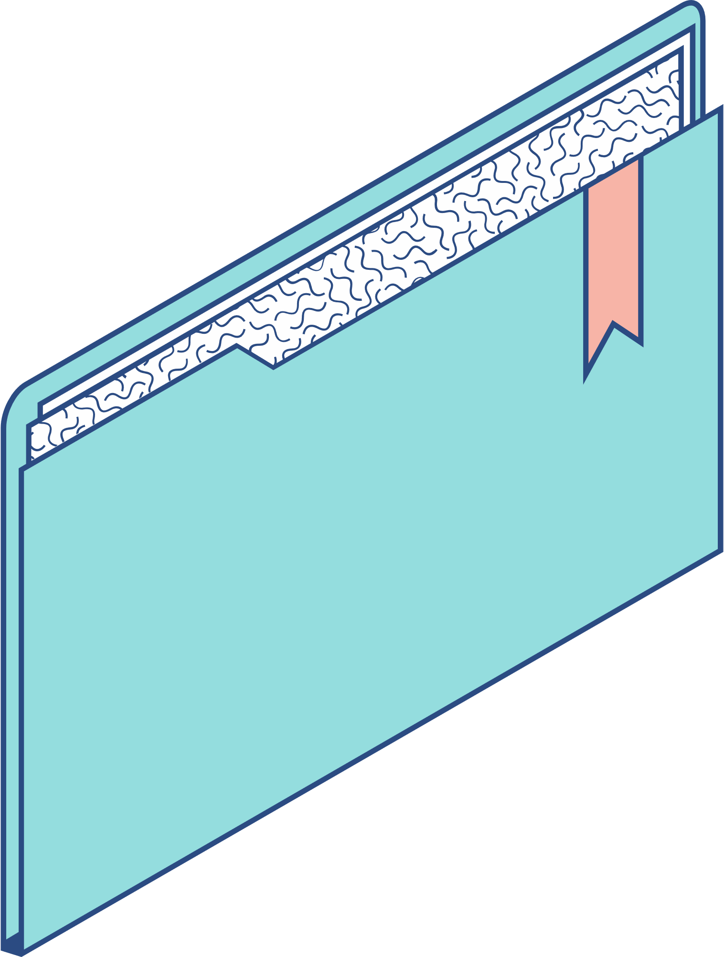
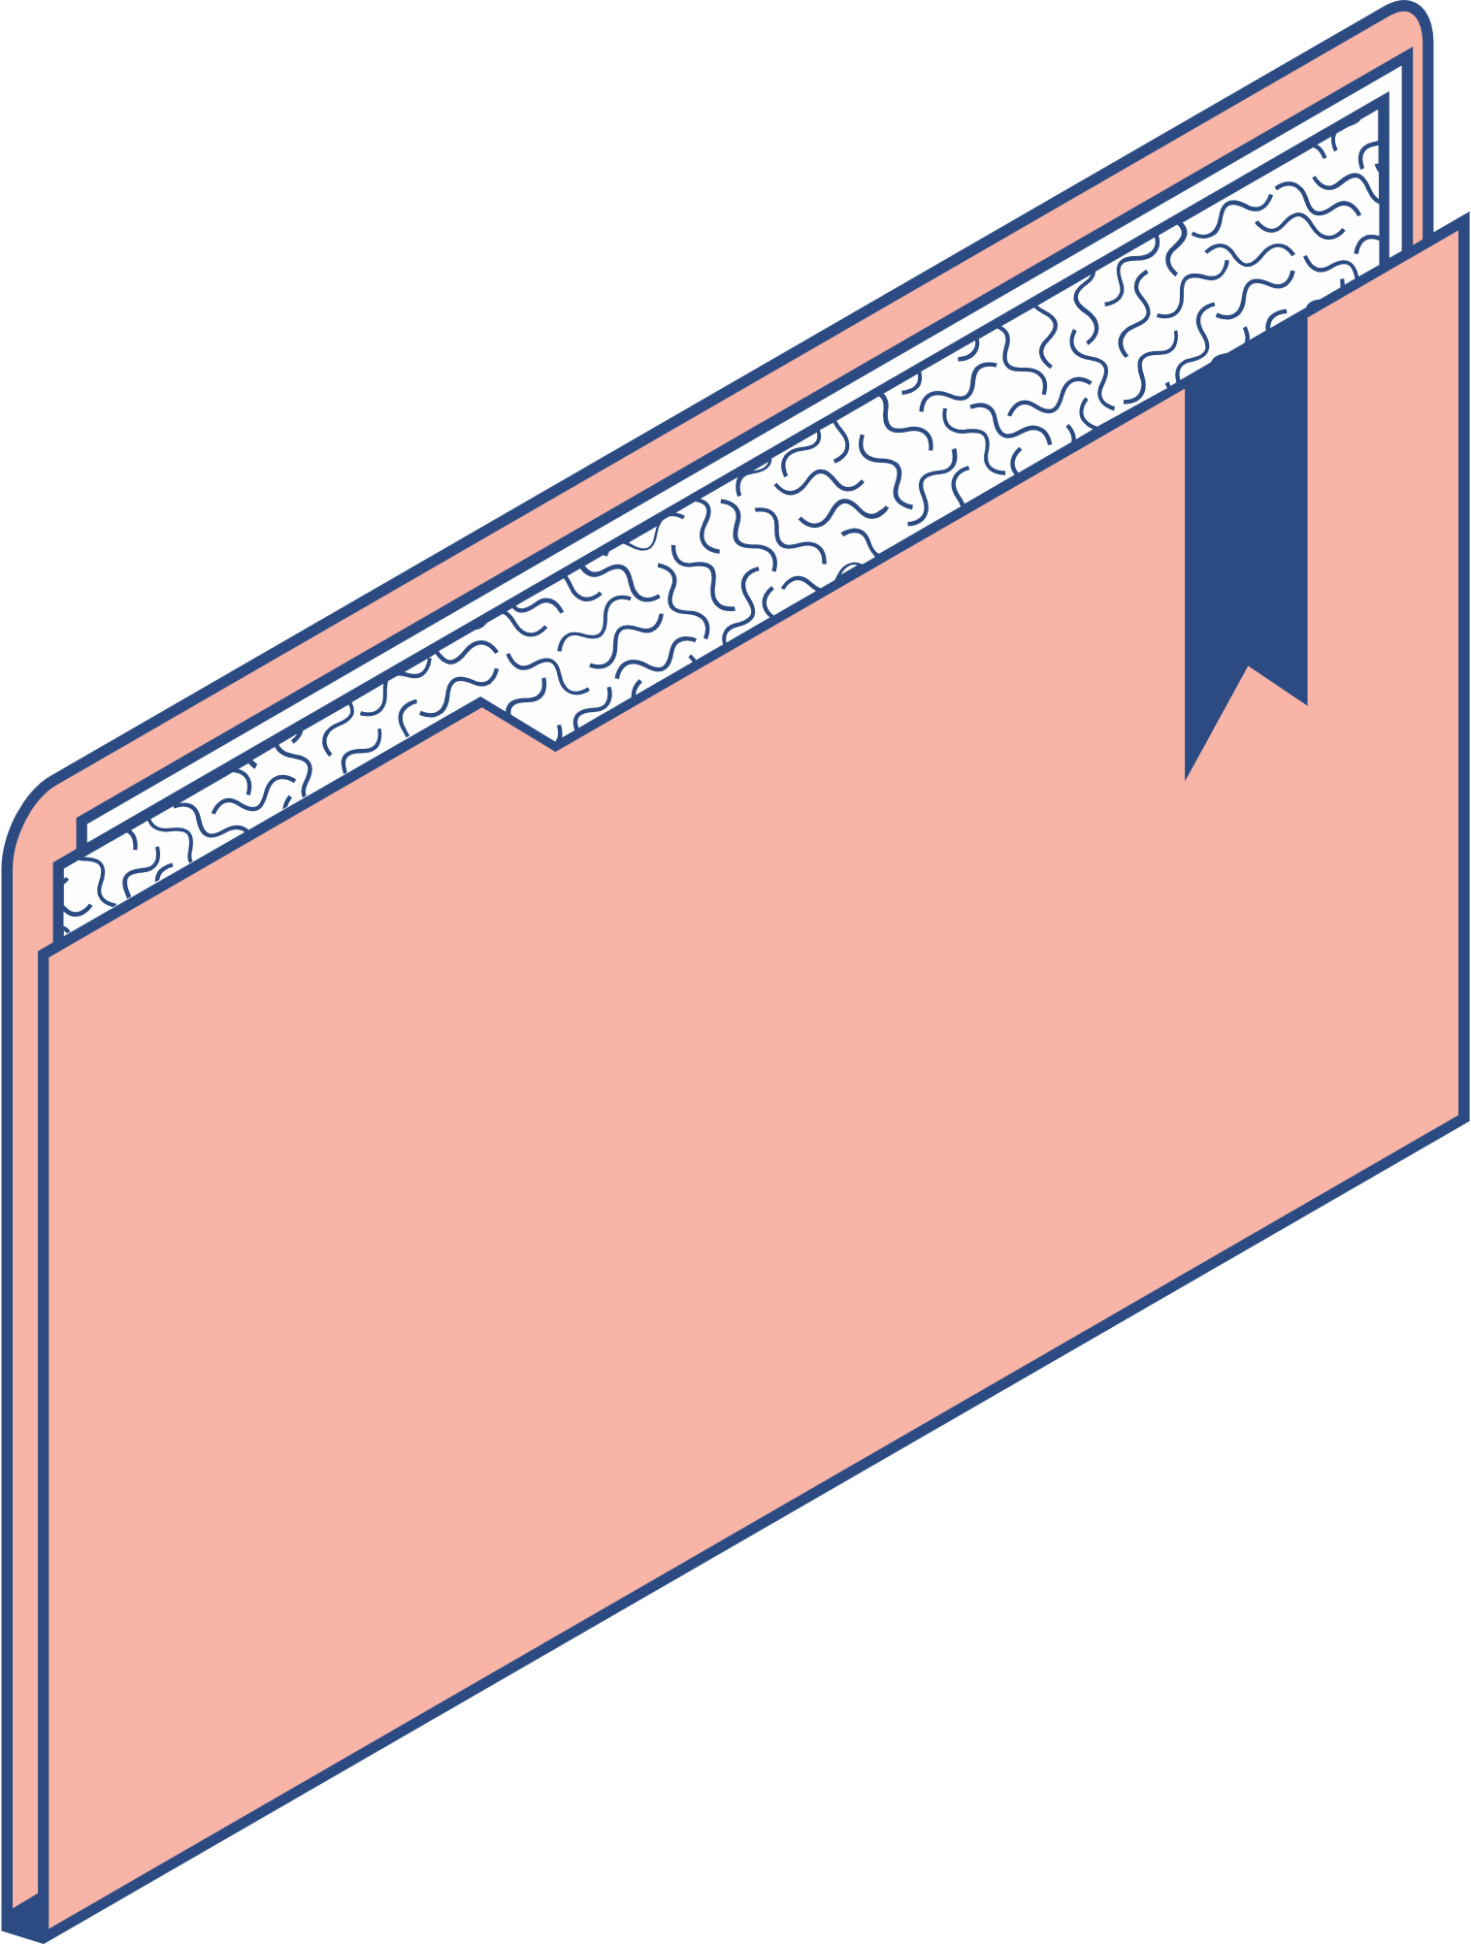

Agenda
KEY TOPICS DISCUSSED IN THIS PRESENTATION
HTML CSS JAVASCRIPT Features Pros and Cons

Slide 3








HTML
CSS
JS
The code that allows your website to actually
do things or have functionality. So if you are building a house, this would be like adding light bulbs that can turn on and off.
It is responsible for actual content of the website. For example if your website is a house then the bricks are html.
It is responsible for styling the website. Like the color of the walls or the shape of your door. It determines how your website will look.

Slide 4




HTML stands for HyperText Markup Language. It is used to design web pages using a markup language. HTML is the combination of Hypertext and Markup language. Hypertext defines the link between web pages. This language is used to annotate (make notes for the computer) text so that a machine can understand it and manipulate text accordingly. The language uses tags to define what manipulation has to be done on the text.

Slide 5
Elements of HTML : Using HTML, a text file is further marked up with additional text describing how the document should be displayed. To keep the markup separate from the actual content of the HTML file, there is a special, distinguishing HTML syntax that is used. These special components are known as HTML tags. The tags can contain name-value pairs known as attributes, and a piece of content . HTML elements always have opening tags, content in the middle and closing tags. Attributes can provide additional information about the element and are included in the opening tag. Elements can be described in one of two ways: Block-level elements start on a new line in the document and take up their own space. Examples of these elements include headings and paragraph tags. Inline elements do not start on a new line in the document and only take up necessary space. These elements usually format the contents of block-level elements. Examples of inline elements include hyperlinks and text format tags.
Elements of HTML : Using HTML, a text file is further marked up with additional text describing how the document should be displayed. To keep the markup separate from the actual content of the HTML file, there is a special, distinguishing HTML syntax that is used. These special components are known as HTML tags. The tags can contain name-value pairs known as attributes, and a piece of content . HTML elements always have opening tags, content in the middle and closing tags. Attributes can provide additional information about the element and are included in the opening tag. Elements can be described in one of two ways: Block-level elements start on a new line in the document and take up their own space. Examples of these elements include headings and paragraph tags. Inline elements do not start on a new line in the document and only take up necessary space. These elements usually format the contents of block-level elements. Examples of inline elements include hyperlinks and text format tags.

Slide 6
Pros Of HTML
Is widely adopted with a large amount of resources available. Is natively run on every browser. Is relatively easy to learn. Has a clean and consistent source code. Is open source and free to use. Can be integrated with other backend programming languages such as PHP.

Slide 7
Cons Of HTML
Does not have very dynamic functionality and is mainly used for static web pages. All components must be created separately even if they use similar elements. Browser behavior can be unpredictable. For example, older browsers may not be compatible with newer features.

Slide 8
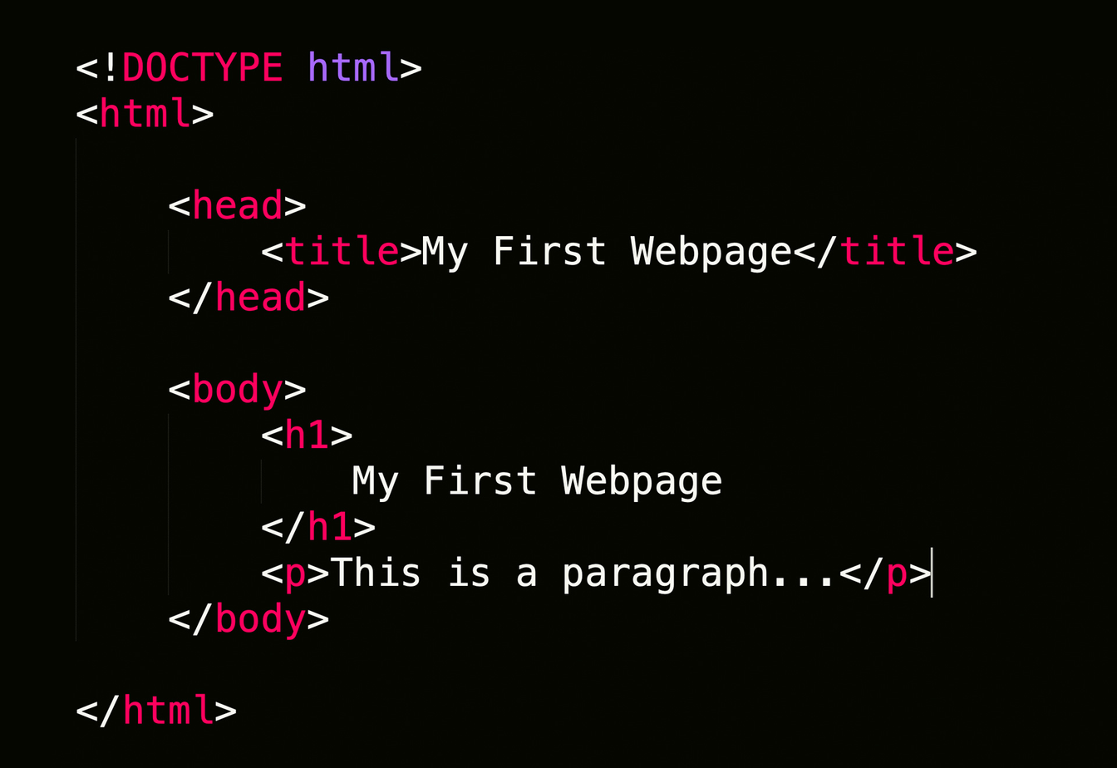
Example Of HTML Code :

Slide 9
CSS stands for cascading style sheet.
CSS is the language we use to style an HTML document.
It describes how a webpage should look. It prescribes colours, fonts, spacing, and much more.
In short, you can make your website look however you want. CSS lets developers and designers define how it behaves, including how elements are positioned in the browser. While HTML uses tags, CSS uses rulesets.
CSS is easy to learn and understand, but it provides powerful control over the presentation of an HTML document.

Slide 10
FEATURES OF CSS:
Separation of Content and Presentation: CSS allows for the separation of HTML content (structure) and CSS styles (presentation), making it easier to maintain and update websites.
Selectors and Styling: CSS provides selectors to target HTML elements and apply styling rules, such as colors, fonts, margins, and padding.
Cascading and Specificity: CSS rules can cascade and have varying levels of specificity, determining which styles take precedence when conflicts arise.

Slide 11

Pros of CSS
By using CSS you simply got to specify a repeated style for element once and use it multiple times as CSS will automatically apply the required styles.
The main advantage of CSS is that style is applied consistently across variety of sites. One instruction can control several areas which is advantageous.
Web designers needs to use few lines of programming for every page improving site speed.
Cascading sheet not only simplifies website development, but also simplifies the maintenance as a change of one line of code affects the whole web site and maintenance time.

Slide 12

Cons of CSS
With CSS, what works with one browser might not always work with another. The web developers need to test for compatibility, running the program across multiple browsers.
There exists a scarcity of security.
After making the changes we need to confirm the compatibility if they appear. The similar change affects on all the browsers.

Slide 13
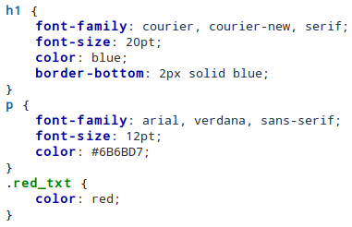
Example Of CSS Code :

Slide 14
JavaScript is a lightweight, cross-platform, and interpreted compiled programming language which is also known as the scripting language for webpages.
It is well-known for the development of web pages, many non-browser environments also use it.
JavaScript can be used for Client-side developments as well as Server-side developments.
Javascript is both imperative and declarative type of language.
JavaScript contains a standard library of objects, like Array, Date, Math a core set of language elements like operators, control structures, and statements.
JAVASCRIPT

Slide 15

FEATURES OF JAVASCRIPT
Dynamic and Weakly Typed: JavaScript is a dynamically typed language, allowing variables to change types during runtime. It's also weakly typed, meaning conversions between types are handled implicitly, making it flexible but requiring careful coding.
First-class Functions: In JavaScript, functions are first-class citizens. They can be assigned to variables, passed as arguments to other functions, and returned from functions, enabling powerful functional programming paradigms.
Event-Driven: JavaScript is well-suited for event-driven programming. It can respond to user interactions (e.g., clicks, keystrokes) and perform actions asynchronously, enhancing the interactivity of web applications.

Slide 16
FEATURES OF JAVASCRIPT
Prototypal Inheritance: Instead of classical inheritance, JavaScript uses prototypal inheritance. Objects can inherit properties and methods directly from other objects, providing a unique and flexible way to structure code.
Cross-platform Compatibility: JavaScript is supported by all major web browsers, making it a cross-platform language. With Node.js, it can also be used for server-side development, achieving full-stack capabilities

Slide 17
PROS OF JAVASCIPT
Simple − JavaScript is simple to comprehend and pick up. Both users and developers will find the structure to be straightforward. Additionally, it is very doable to implement, saving web developers a ton of money when creating dynamic content.
Speed − JavaScript is a "interpreted" language, it cuts down on the time needed for compilation in other programming languages like Java. Another client-side script is JavaScript, which accelerates programm execution by eliminating the wait time for server connections.
No matter where JavaScript is hosted, it is always run in a client environment to reduce bandwidth usage and speed up execution.
Interoperability − Because JavaScript seamlessly integrates with other programming languages, many developers favor using it to create a variety of applications. Any webpage or the script of another programming language can contain it.

Slide 18
CONS OF JAVASCRIPT
Cannot Debug − Although some HTML editors allow for debugging, they are not as effective as editors for C or C++. Additionally, the developer has a difficult time figuring out the issue because the browser doesn't display any errors.
Unexpected stop of rendering − The website's entire JavaScript code can stop rendering due to a single error in the code. It appears to the user as though JavaScript is absent. The browsers, however, are very forgiving of these mistakes.
Client-side Security − The user can see the JavaScript code; it could be misused by others. These actions might involve using the source code anonymously. Additionally, it is very simple to insert code into the website that impair the security of data transmitted via the website.
Inheritance − JavaScript does not support multiple inheritance; only one inheritance is supported. This property of object-oriented languages might be necessary for some programmes.

Slide 19



THANK YOU

